Slide 1

Bangalore Institute Of Technology Department of Master of Computer Applications
PLACEMENT-DIARIES
(Training and Placement Cell Management System)
UNDER THE GUIDANCE OF
Dr. T. Vijaykumar
PRESENTED BY
Patil Balasaheb Tatyasaheb (1BI22MC062)

Slide 2
Content
Introduction
Abstraction
Scope of the project
Literature survey
Modules in project
Hardware and Software requirements
Conclusion

Slide 3
Introduction
The project is aimed at developing an online web application for the training and placement department of the college.
This system can be used as an application for the TPO of the college to manage the student information with regard to placement.
Student logging should be able to upload their information. Organization’s representatives logging in may also access/search information put up by the students.
Overall, it will reduce the paper work and utilize the maximum capability of the setup and organization as well as it will save time and money.

Slide 4
Abstract
Training and Placement Cell is important part of any educational institute in which most of the work till now is being done manually.
The main aim of this project is the automation of Training and Placement cell of college.
Students can directly apply for the company which will be provided by the system.
The main advantage of our application is that if students does not fit in the eligibility criteria due to less marks and has good technical knowledge then the HR can take separate test for those students through this application

Slide 5
Scope of the project
The main objective of the Training and Placement Management System is to build an web application to manage the details of Training, Student, Technical Skill, Placement and placement cell.
Our project has a big scope to do for the purpose of training and placement of the student in colleges.
Students can access previous information about placement.
Students can maintain their Profile and can update it.

Slide 6
Literature survey
The problems in the existing systems are as follows:
Students manually fill the forms every time for applying for the job.
TPO collects marks of the student from green book.
From the data collected through filled-forms and green book, excel sheets are prepared. These excel sheets are used to prepare a list of eligible students.
Advantage in the proposed System is:
So, to overcome these problem the placement Diaries is developed which provide easy coordination among TPO, Student and the HR.
Student information can be maintained in the database and ensures the data correctness and integrity

Slide 7
Modules in the project
“Training and Placement Cell" has been divided into three modules. Each module is bound to have its own specific functions.
Admin Module: This module mainly deals with Students and company details, Admin is authorized person who can make changes in the site at any time with respect to student and the company. Also, admin can train student online by uploading important notes or Videos with respect to job etc.
Company Module: This module mainly deals with Company details and Students details such as selected students list, applied students list etc.
Student Module: This module mainly deals with Student profile details and company job details by logging in into the website with their respective login id and password.

Slide 8
Data Flow-Diagram Zero-Level
Company
Study Material
Placement
Training and Placement Cell
Workshop
Student
Job

Slide 9
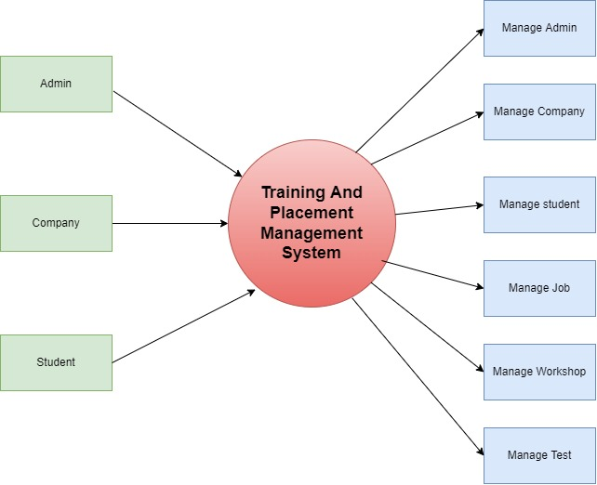
Data Flow-Diagram First-Level

Slide 10
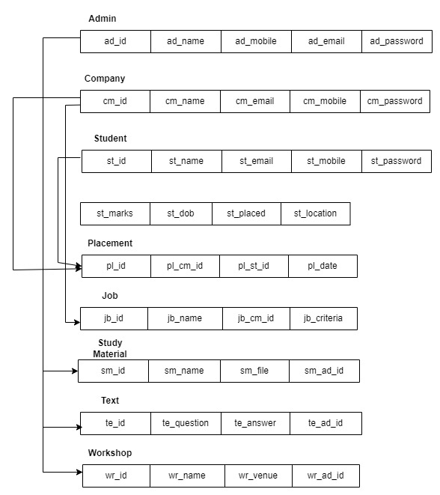
Schema Diagram

Slide 11
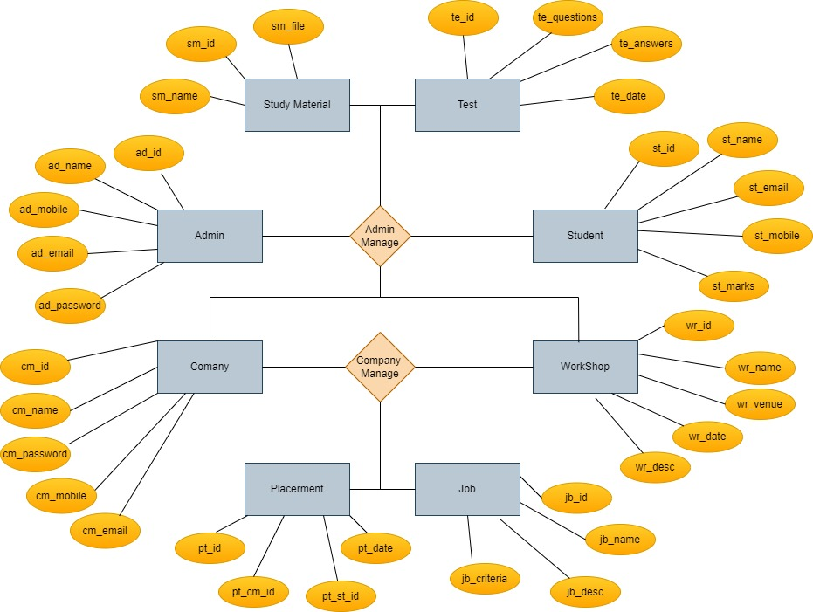
ER Diagram

Slide 12
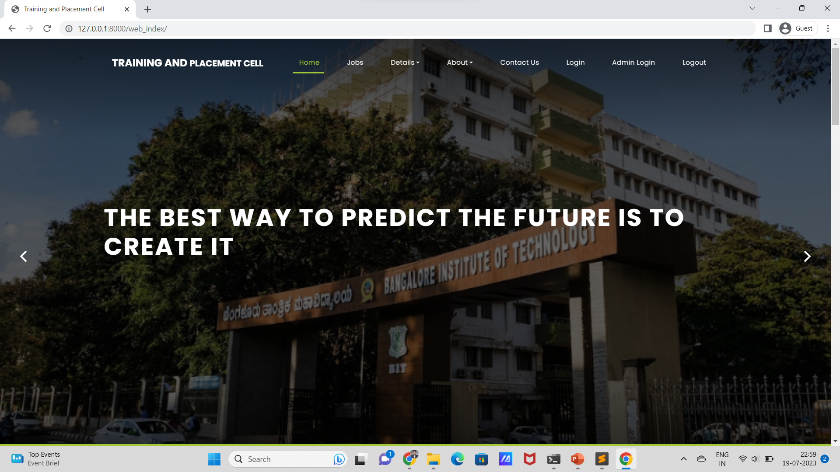
Home Page

Slide 13
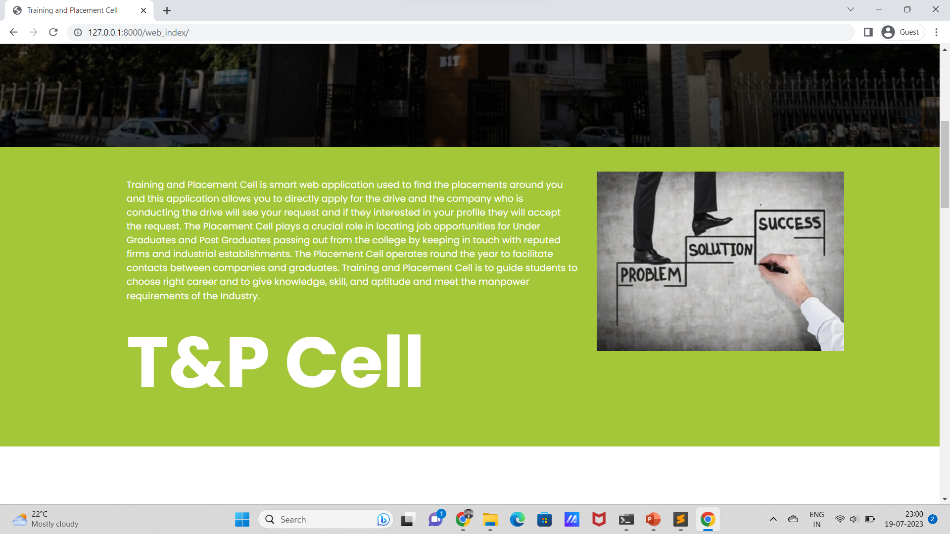


Slide 14
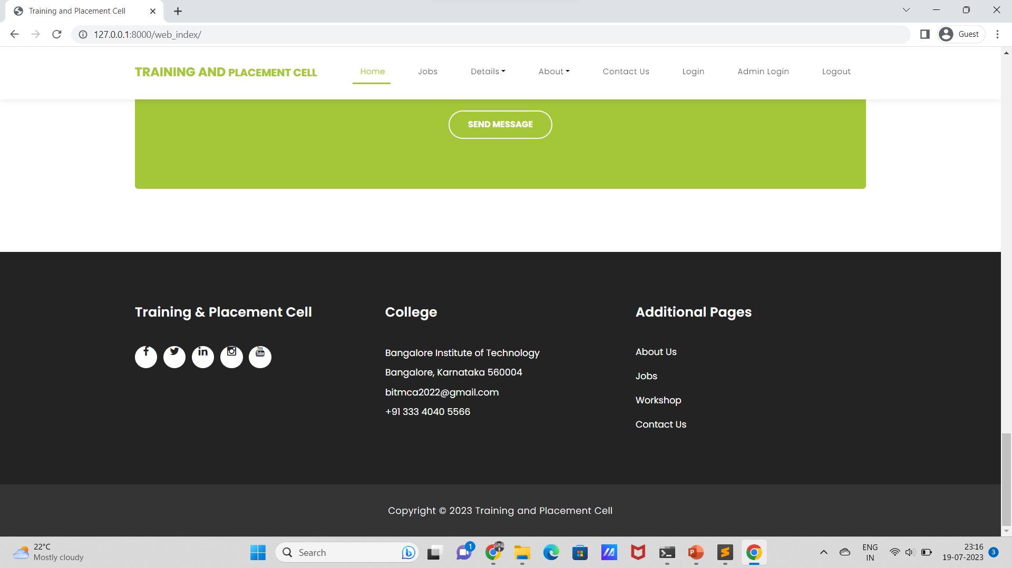

Slide 15
Hardware and Software requirement
Hardware requirement:
RAM : Min 2 GB or more
CPU : 2 GHz or faster
Architecture : 32-bit or 64-bit
Processor : Processor – Intel Atom or higher
Storage : Min 5GB or more
Software requirement:
Coding Language : HTML, CSS, JS, Bootstrap and Python
Database : MySQL
Code Editor : Sublime Text Editor
Tools and technologies:
Sublime Text Editor
MongoDB

Slide 16
Conclusion
The system eliminates difficulties within the existing system. It's developed in a very user-friendly manner.
The system is fast and any transaction is viewed or retaken at any level.
This software reduces the work and achieving accuracy, user satisfaction.
Here we designed and implemented the training and placement database management system which is based on html and Python with database.

Slide 17
THANK YOU

